Slide 1
Group #10 – Serve & Save
April 14, 2023
James Nguyen, Niman Ahmed, Sophanda Long, and Thurman Thoma

Slide 2

Problem:
What can we do to have students volunteer?
How do we get students to invest and save?
How can we encourage students to live a healthy lifestyle?

Slide 3
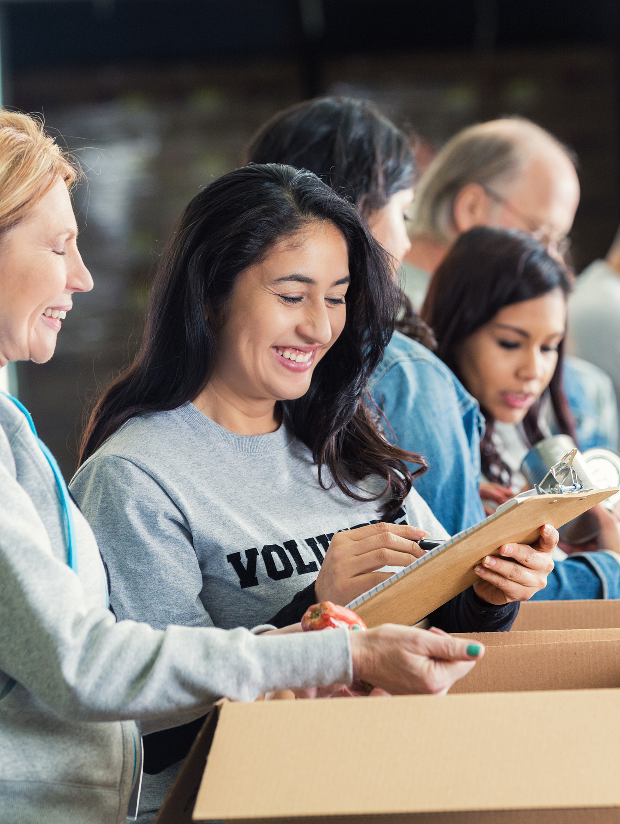
Concept: Serve & Save
Let's build an app to incentivize students to volunteer and teach them how to save money by making deposits to their savings account.

Slide 4

Demo Time

Slide 5
Requirements
One voluntering event per month
$40 Deposit to the savings account

Slide 6
Demo Time

Slide 7
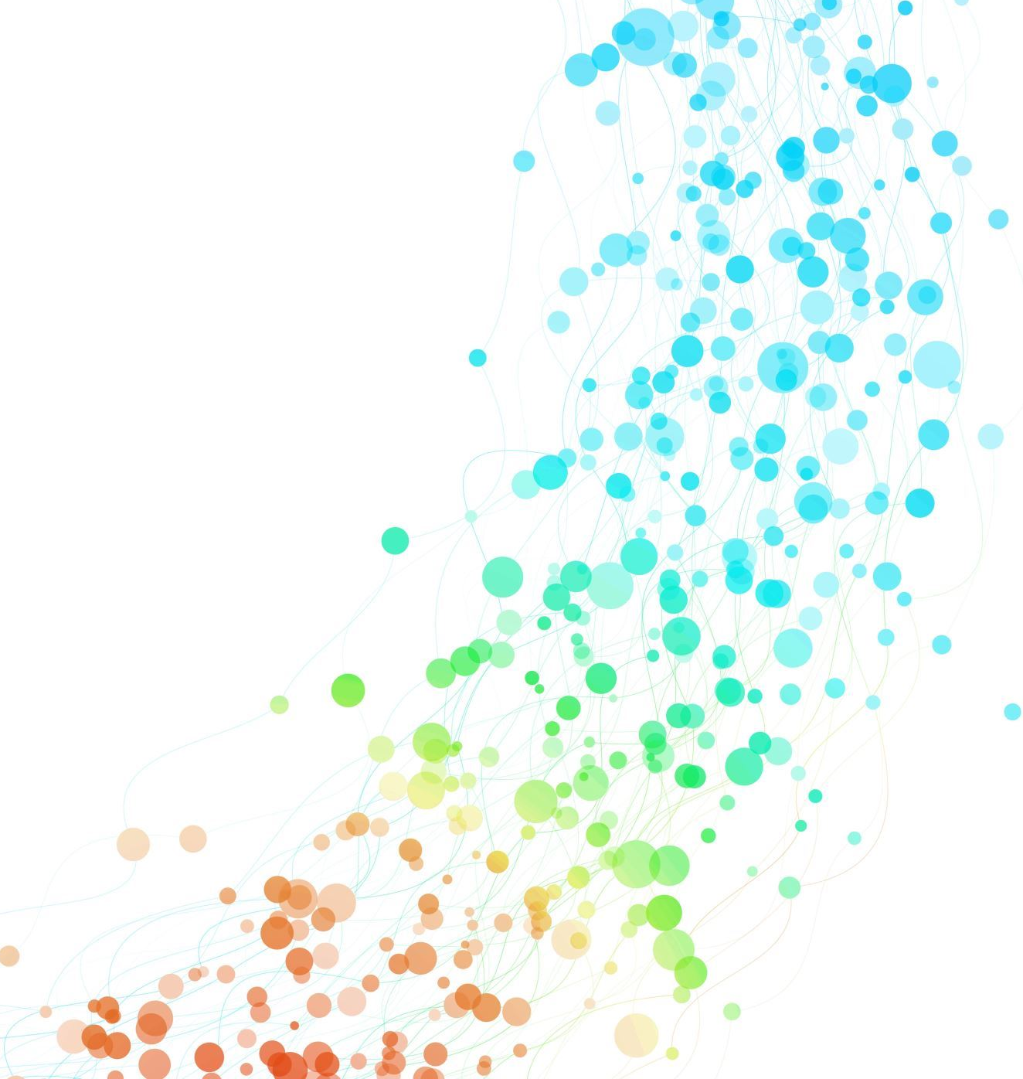
What we like about Serve&Save
Encourages students to make monthly deposit goals
Rewards students to make healthy lifestyle transactions
Allows US Bank to give back to their community be rewarding volunteering

Slide 8
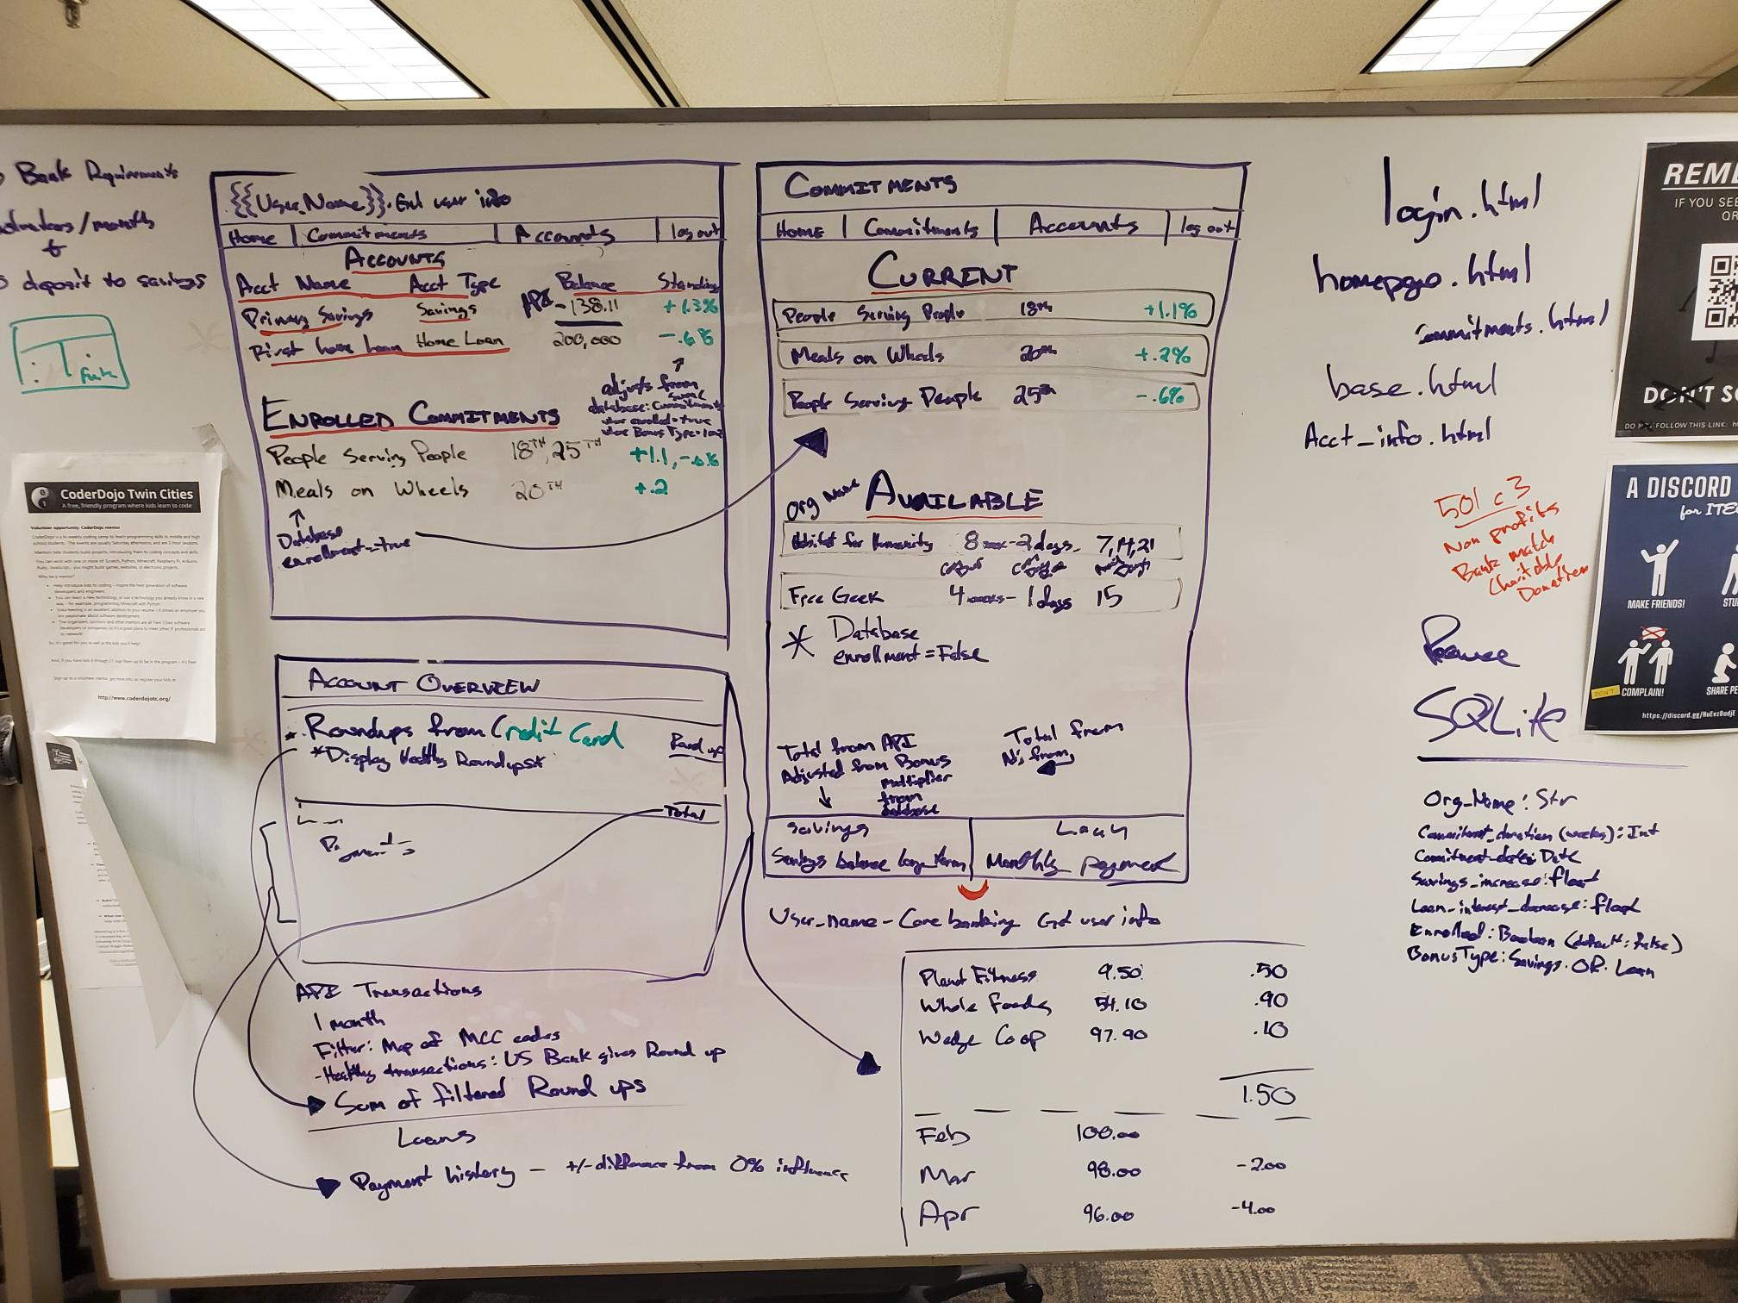
Initial Design

Slide 9
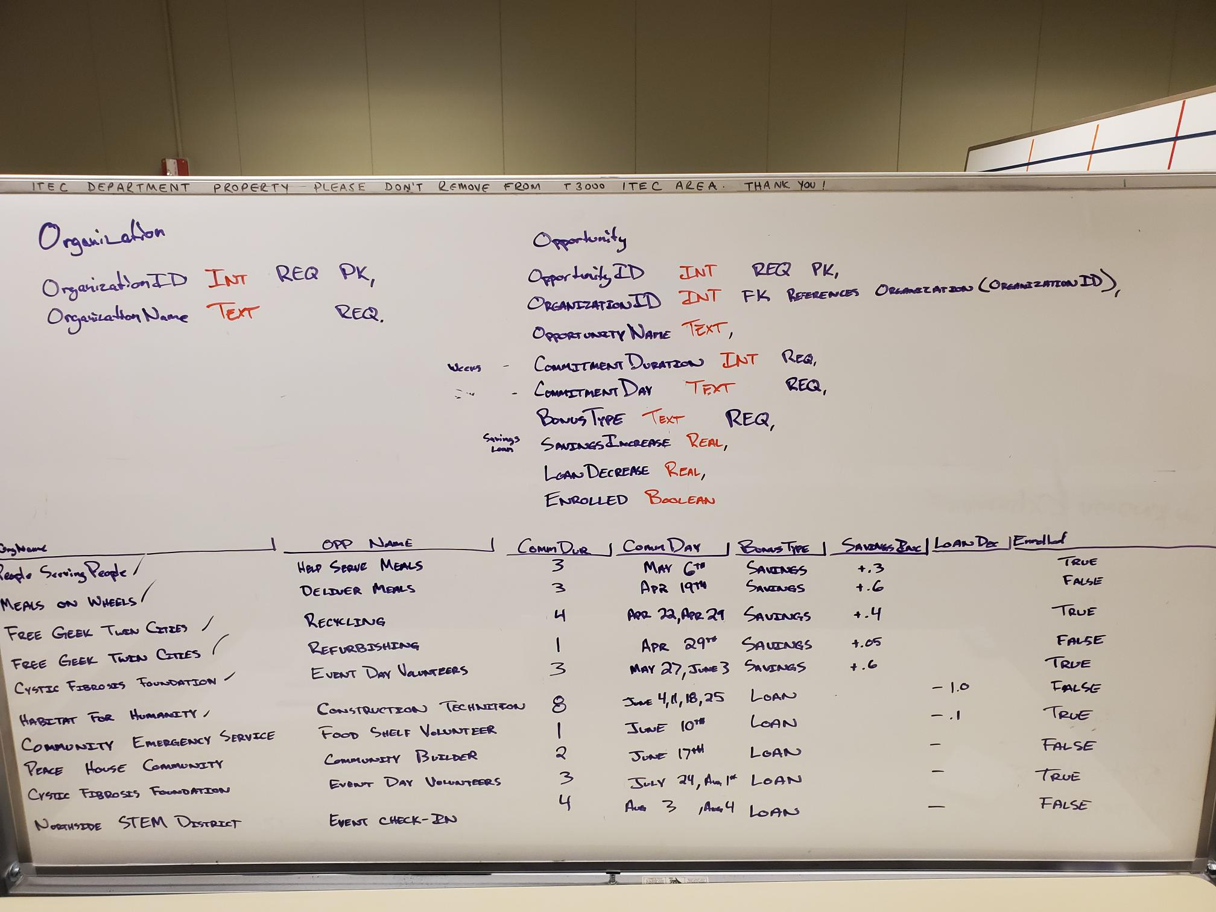
Database Design

Slide 10

Technology Used: Python - Flask - python-dotenv - Requests Javascript HTML/CSS US Bank API - Core Banking - Money Movement

Slide 11

THANK YOU MCTC and US Bank for this opportunity!

